Slide 1
Introduction
Signal processing is a discipline in electrical engineering and in mathematics that deals with analysis and processing of analog and digital signals. These signals include transmission signals , sound or voice signals , image signals , and other signals etc.
Out of all these signals , the field that deals with the type of signals for which the input is an image and the output is also an image is done in image processing. As the name suggests, it deals with the processing on images.
Analog signals have continuous electrical signals, while digital signals have non-continuous electrical signals.
Analog image processing common example is the television image.
The digital image processing deals with developing a digital system that performs operations on a digital image.

Slide 2
Prerequisites
Since DIP(Digital Image Processing) is a subfield of signals and systems , so it would be good if you already have some knowledge about signals and systems , but it is not necessary. But you must have some basic concepts of digital electronics.
Basic understanding of calculus , probability and differential equations is also required for better understanding.
Basic programming skills
Reference books –
1. Digital Image Processing - R. Gonzalez, R. Woods
2. Computer Graphics - Hearn, Baker, Pearson education

Slide 3
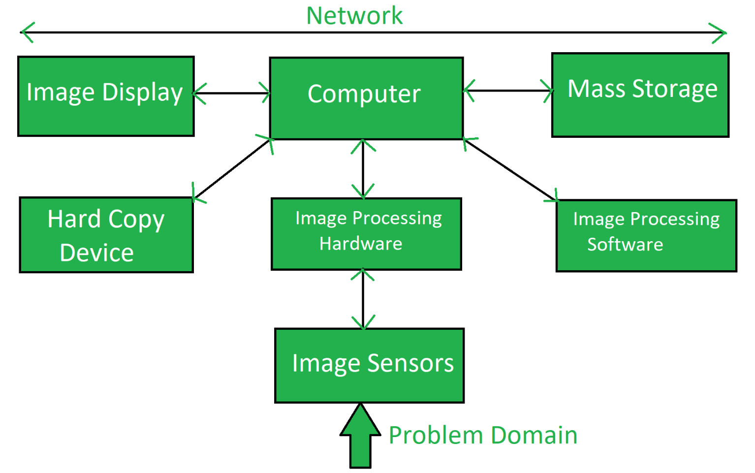
Components of Image Processing System – Image Processing System is the combination of the different elements involved in the digital image processing. Digital image processing is the processing of an image by means of a digital computer. Digital image processing uses different computer algorithms to perform image processing on the digital images.

Slide 4
Image Sensors: Image sensors senses the intensity, amplitude, co-ordinates and other features of the images and passes the result to the image processing hardware. It includes the problem domain.
Image Processing Hardware: Image processing hardware is the dedicated hardware that is used to process the instructions obtained from the image sensors. It passes the result to general purpose computer.
Computer: Computer used in the image processing system is the general purpose computer that is used by us in our daily life.
Image Processing Software: Image processing software is the software that includes all the mechanisms and algorithms that are used in image processing system.
Mass Storage: Mass storage stores the pixels of the images during the processing.
Hard Copy Device: Once the image is processed then it is stored in the hard copy device. It can be a pen drive or any external ROM device.
Image Display: It includes the monitor or display screen that displays the processed images.
Network: Network is the connection of all the above elements of the image processing system.

Slide 5
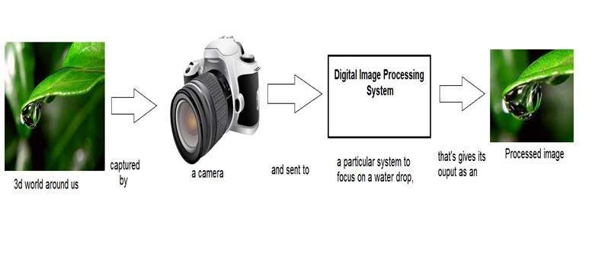
How it works - In the below figure, an image has been captured by a camera and has been sent to a digital system to remove all the other details, and just focus on the water drop by zooming it in such a way that the quality of the image remains the same.

Slide 6
What is an Image?
An image is a two-dimensional function f(x,y), where x and y are the spatial (plane) coordinates, and the amplitude of f at any pair of coordinates(x,y) is called the intensity of the image.
What is a digital image?
If x,y and the amplitude values of f are finite and discrete quantities, we call the image a digital image. A digital image is composed of a finite number of elements called pixels, each of which has a particular location and value.
Each point at every (x,y) is called amplitude or intensity of an image. When this amplitude and x,y points are discrete, then we call it a digital image. if the values are continuous values, then we call it an analog image.

Slide 7
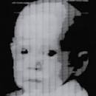
First Digital Photograph Ever: Russell Kirsch in 1957 made a 176×176 pixel digital image by scanning a photograph of his three-month-old son.

Slide 8
Pixel/Picture elements/Image elements :
In a digital image, all the coordinates on 2-D function and the corresponding values are finite. Each value available in every location is considered as a pixel. In other words, a pixel is the smallest part of an image. So a digital image can be thought as 2-d array of pixels.
Gray Level:
Each pixel has some intensity value which is called Gray level or Gray value. These values are usually represented in 8-bit int. So the range of values from 0 to 255. The values near to 0 indicates darker regions and the values near 255 represent brighter regions.

Slide 9
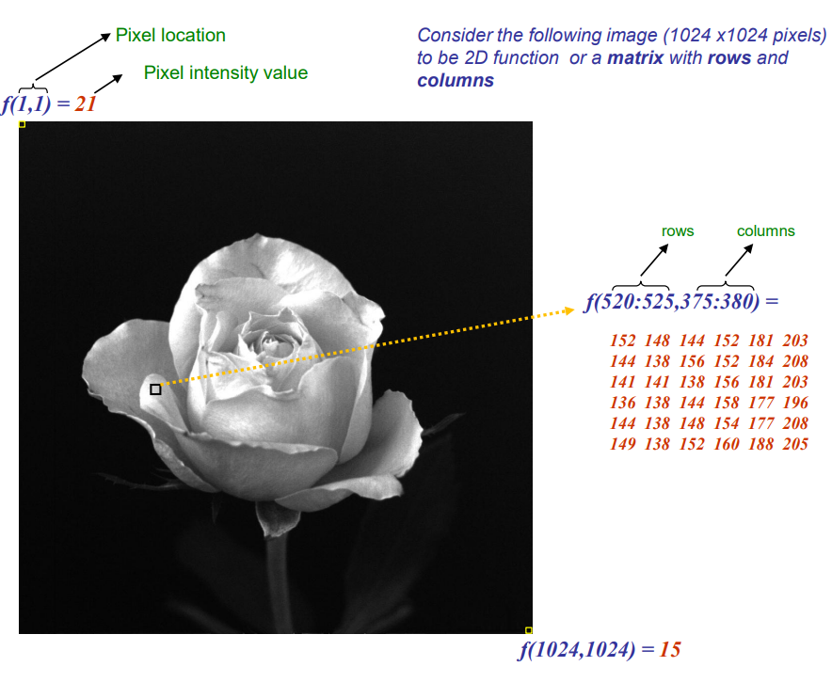
In 8 bit representation, pixel intensity values change between 0(black) and 255(white)

Slide 10
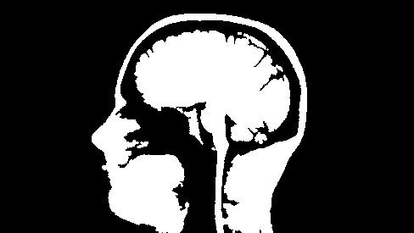
Types of Images: Binary, Grayscale, Color
BINARY IMAGE: The binary image as its name suggests, contain only two pixel elements i.e 0 & 1,where 0 refers to black and 1 refers to white. This image is also known as Monochrome. In other words, a binary image has only two possible gray values or intensities 0 and 255, there are no intermediate values. Binary images are used as masks for indicating the pixels of interest in many image processing tasks. Below is the example of binary image.
BINARY IMAGE

Slide 11
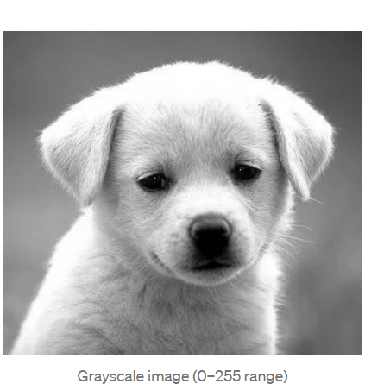
Grayscale Image
Grayscale image has range of values from 0 to 255 i.e each pixel location can have any value between 0 and 255. (127 stands for Gray). If you watch old films around the 1950s, you are watching grayscale images (films are nothing but videos which are collection of individual images in proper sequence).
In an 8-bit image each pixel occupies exactly one byte. This means each pixel has 2⁸ (256) possible numerical values, from 0 to 255.

Slide 12
Color Image
Both binary image and grayscale image are 2-dimensional arrays, where at every location, you have one value to represent the pixel. To represent a color image, we need more than one value for each pixel. Typically one needs 3 values for each pixel to represent any color. This came from the idea that any color can be formed by combining 3 basic colors Red, Blue and Green. This is actually called RGB color format.
8 bit COLOR FORMAT – It is the most famous image format. It has 256 different shades of colors in it. Also called Grayscale image.
16 bit COLOR FORMAT - It has 65,536 different colors in it. It is also known as High Color Format. (5 bits for R, 6 bits for G, 5 bits for B)
24 bit COLOR FORMAT - The 24-bit color format is also known as the true color format. As 24 can be equally divided on 8, so it is distributed equally between 3 different colors (8 bits for R, 8 bits for G, 8 bits for B)

Slide 13
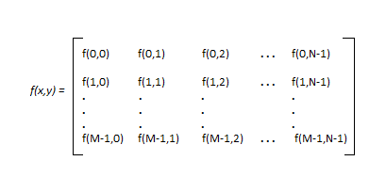
Image as a Matrix
As we know, images are represented in rows and columns we have the following syntax in which images are represented:
The right side of this equation is digital image by definition. Every element of this matrix is called image element , picture element , or pixel.

Slide 14
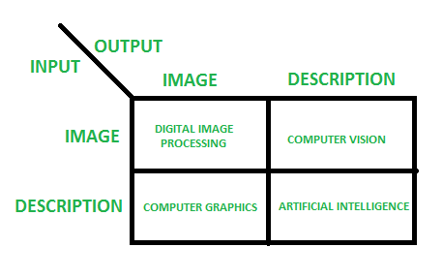
OVERLAPPING FIELDS WITH IMAGE PROCESSING

Slide 15
PHASES OF IMAGE PROCESSING:
1.ACQUISITION– It could be as simple as being given an image which is in digital form. The main work involves:
a) Scaling b) Color conversion(RGB to Gray or vice-versa)
2.IMAGE ENHANCEMENT– It is amongst the simplest and most appealing in areas of Image Processing it is also used to extract some hidden details from an image and is subjective. Also a method that is quite useful for useful for enhancing X-ray images may not be the best approach for satellite images taken in the EM spectrum.
3.IMAGE RESTORATION– It also deals with appealing of an image but it is objective(Restoration is based on mathematical or probabilistic model or image degradation).
4.COLOR IMAGE PROCESSING– It deals with pseudocolor and full color image processing color models are applicable to digital image processing.
5.WAVELETS AND MULTI-RESOLUTION PROCESSING– It is foundation of representing images in various degrees.

Slide 16
PHASES OF IMAGE PROCESSING (contd)..
6.IMAGE COMPRESSION-It involves in developing some functions to perform this operation. It mainly deals with image size or resolution.
7.MORPHOLOGICAL PROCESSING-It deals with tools for extracting image components that are useful in the representation & description of shape.
8.SEGMENTATION PROCEDURE-It includes partitioning an image into its constituent parts or objects. Autonomous segmentation is the most difficult task in Image Processing.
9.REPRESENTATION & DESCRIPTION-It follows output of segmentation stage, choosing a representation is only the part of solution for transforming raw data into processed data.
10.OBJECT DETECTION AND RECOGNITION-It is a process that assigns a label to an object based on its descriptor.

Slide 17
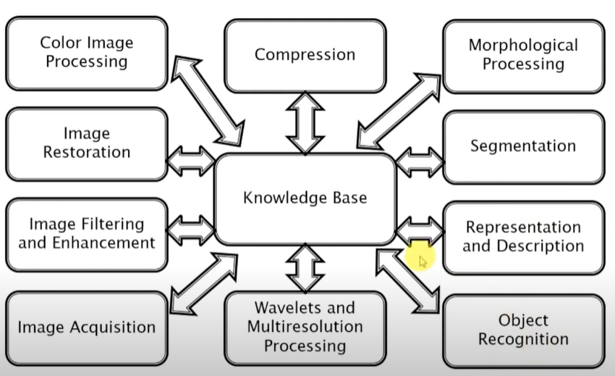
Fundamental steps in image processing

Slide 18
THANK YOU
Prepared by -
Mrs. Jheelam Mondal
Asst. Prof, CSE department
Haldia Institute of Technology

